Slide 1

FACE TO EMOJI USING OPEN CV AND HAAR CASCADE CLASSIFIER
Date: 29 May 2021
M SREE HARIKA : 17WH1A0531
T. ADHI LAKSHMI : 17WH1A0541
G.SOWMYA : 18WH5A0501
Internal Guide: Ms.B.Nagaveni
Designation: Assistant Professor
Department of Computer Science & Engineering
BVRIT HYDERABAD College of Engineering for Women

Slide 2
ABSTRACT
Facial emoji recognizer is an end user application which detects the expression of the person in the video being captured by the camera. The smiley relevant to the expression of the person in the video is shown on the screen which changes with the change in the expressions. Facial expressions are important in human communication and interactions. Also, they are used as an important tool in studies about behavior and in medical fields. Facial emoji recognizer provides a fast and practical approach for non-meddlesome emotion detection. The purpose was to develop an intelligent system for facial based expression classification using CNN algorithm. Haar classifier is used for face detection and CNN algorithm is utilized for the expression detection and giving the emoticon relevant to the expression as the output.
BVRIT HYDERABAD College of Engineering for Women

Slide 3
ARCHITECTURE
Data Preparation
Model Creation
CNN Model Building
Image Capturing
Output
BVRIT HYDERABAD College of Engineering for Women

Slide 4
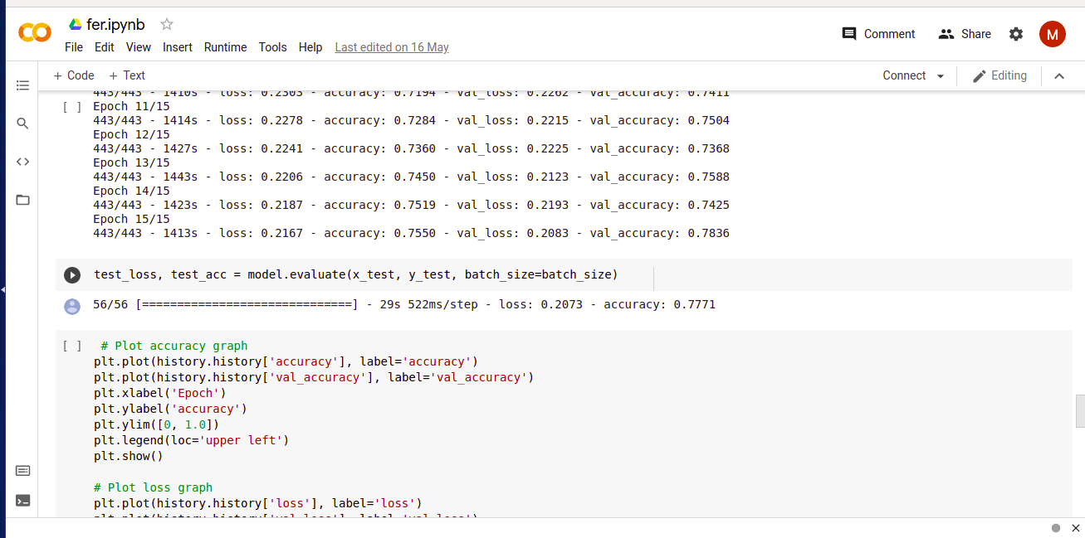
ACCURACY
BVRIT HYDERABAD College of Engineering for Women

Slide 5
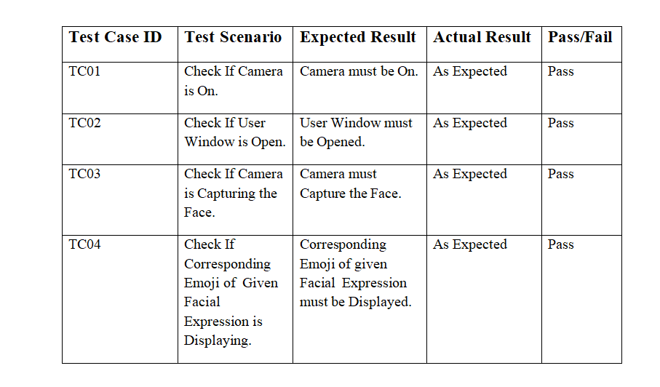
TEST CASES
BVRIT HYDERABAD College of Engineering for Women

Slide 6
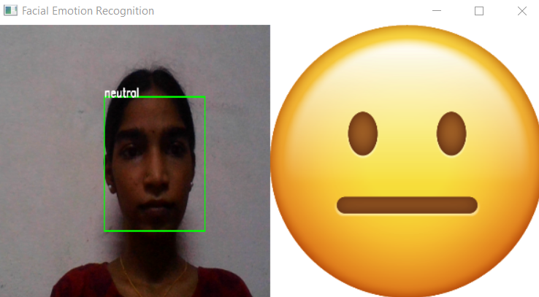
OUTPUT
BVRIT HYDERABAD College of Engineering for Women

Slide 7
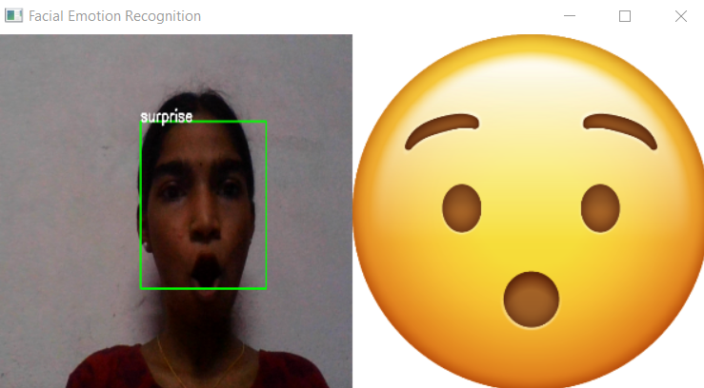
BVRIT HYDERABAD College of Engineering for Women

Slide 8
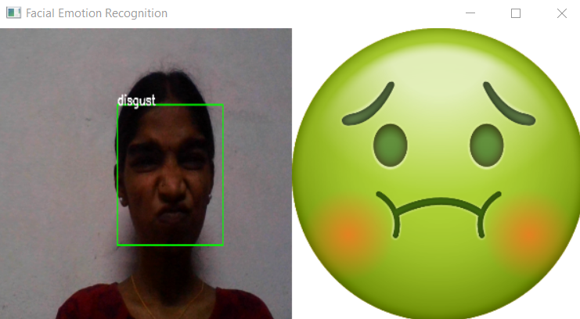
BVRIT HYDERABAD College of Engineering for Women

Slide 9
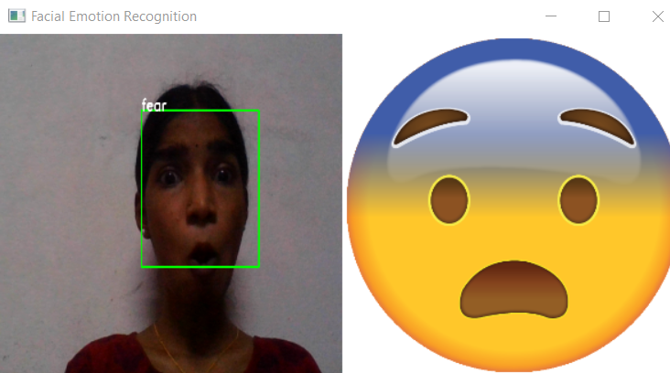
BVRIT HYDERABAD College of Engineering for Women

Slide 10
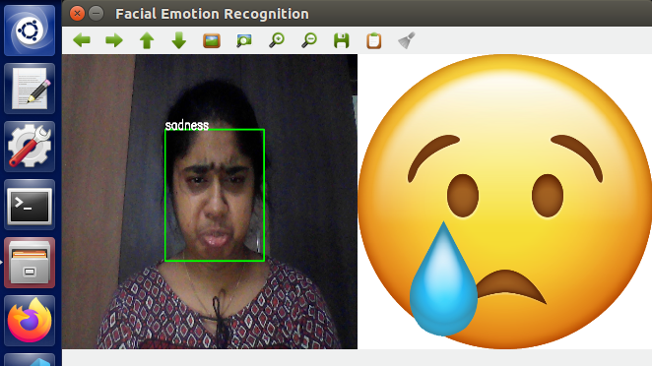
BVRIT HYDERABAD College of Engineering for Women

Slide 11
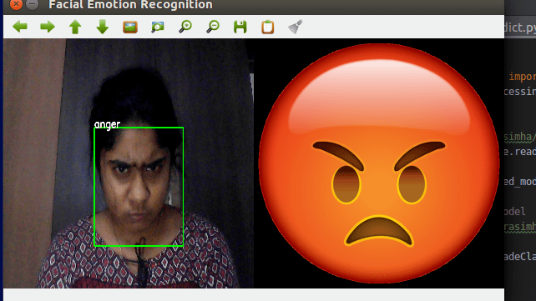
BVRIT HYDERABAD College of Engineering for Women

Slide 12
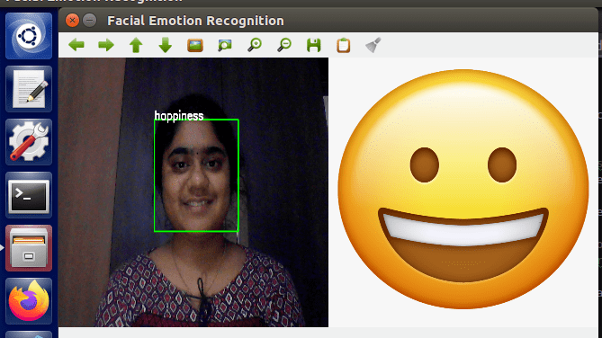
BVRIT HYDERABAD College of Engineering for Women

Slide 13
References
Base Paper URL - https://www.researchgate.net/publication/333686711_Facial_Emoji_Recognition
Dataset is taken from https://www.kaggle.com/c/emotion-detection-from-facial- expressions/data
Open CV from https://opencv.org/
BVRIT HYDERABAD College of Engineering for Women

Slide 14
Thank you
BVRIT HYDERABAD College of Engineering for Women

